Slide 1
Module 18: Protection
Goals of Protection
Domain of Protection
Access Matrix
Implementation of Access Matrix
Revocation of Access Rights
Capability-Based Systems
Language-Based Protection

Slide 2
Protection
Operating system consists of a collection of object|s, hardware or software
Each object has a unique name and can be accessed through a well-defined set of operations.
Protection problem - ensure that each object is accessed correctly and only by those processes that are allowed to do so.

Slide 3
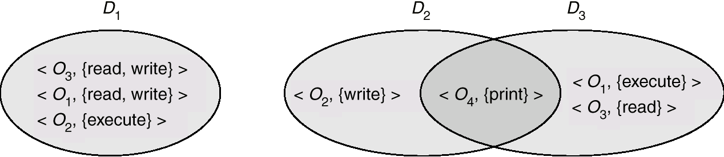
Domain Structure
Access-right = <object-name, rights-set>
Rights-set is a subset of all valid operations that can be performed on the object.
Domain = set of access-rights

Slide 4
Domain Implementation
System consists of 2 domains:
  User
  Supervisor
UNIX
  Domain = user-id
  Domain switch accomplished via file system.
    Each file has associated with it a domain bit (setuid bit).
    When file is executed and setuid = on, then user-id is set to owner of the file being executed. When execution completes user-id is reset.

Slide 5
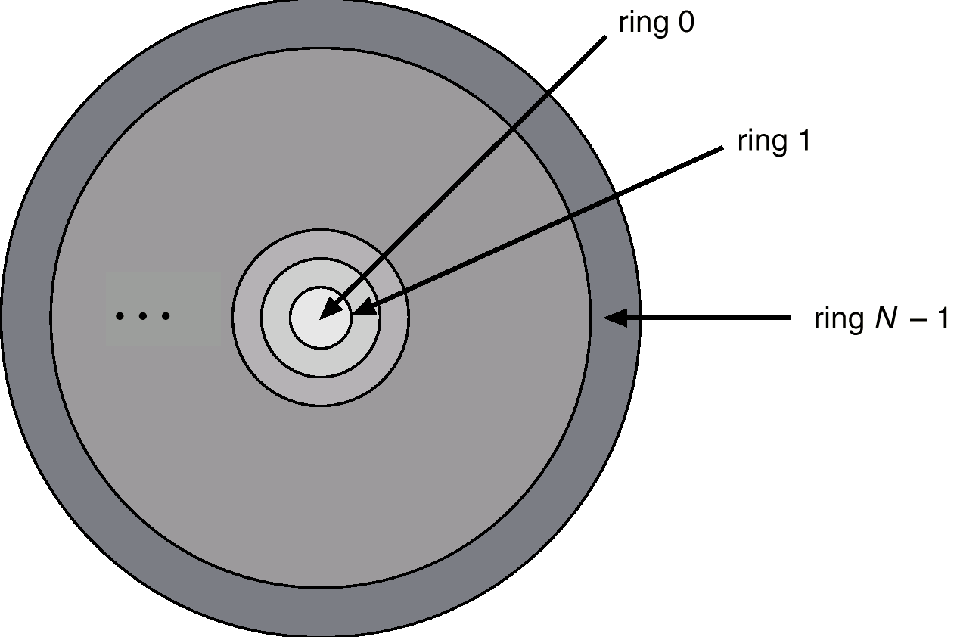
Multics Rings
Let D_{i} and D_{j} be any two domain rings.
If j < I ⇒ D_{i} ⊆ D_{j}

Slide 6
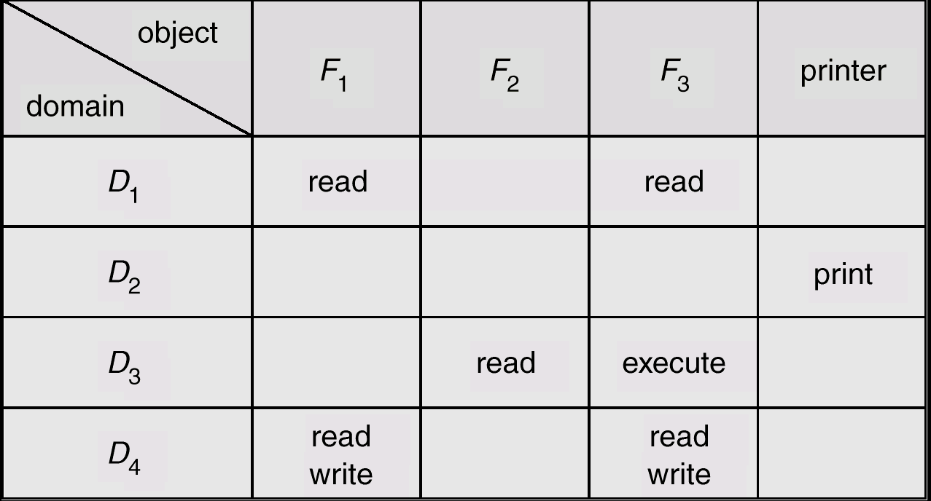
Access Matrix
Figure 1

Slide 7
Use of Access Matrix
If a process in Domain D_{i} tries to do “op” on object O_{j}, then “op” must be in the access matrix.
Can be expanded to dynamic protection.
  Operations to add, delete access rights.
  Special access rights:
    owner of O_{i}
    copy op from O_{i} to O_{j}
    control – D_{i} can modify D_{j}s access rights
    transfer – switch from domain D_{i} to D_{j}

Slide 8
Use of Access Matrix (Cont.)
Access matrix design separates mechanism from policy.
  Mechanism
    Operating system provides Access-matrix + rules.
    If ensures that the matrix is only manipulated by authorized agents and that rules are strictly enforced.
  Policy
    User dictates policy.
    Who can access what object and in what mode.

Slide 9
Implementation of Access Matrix
Each column = Access-control list for one object
Defines who can perform what operation.
Domain 1 = Read, Write
Domain 2 = Read
Domain 3 = Read

Each Row = Capability List (like a key)
Fore each domain, what operations allowed on what objects.
      Object 1 – Read
      Object 4 – Read, Write, Execute
      Object 5 – Read, Write, Delete, Copy

Slide 10
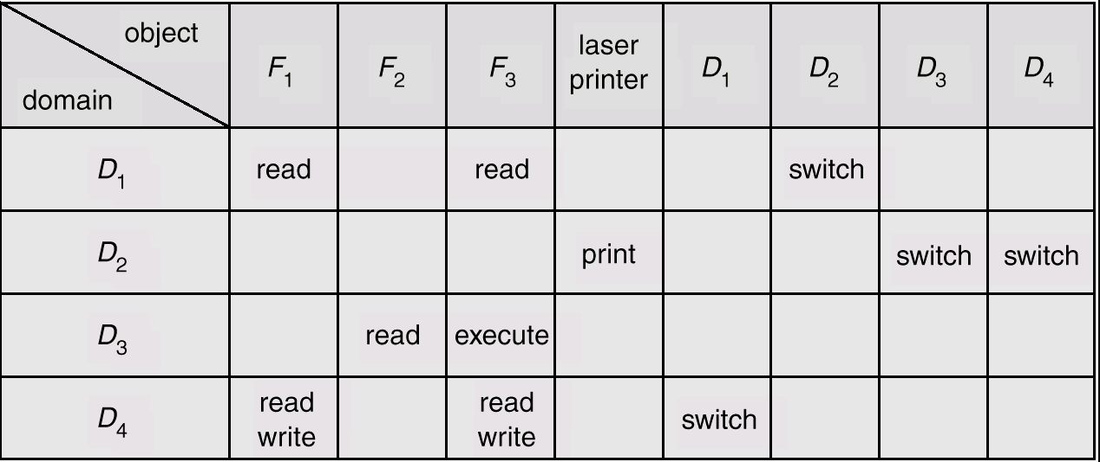
Access Matrix of Figure 1 With Domains as Objects
Figure 2

Slide 11
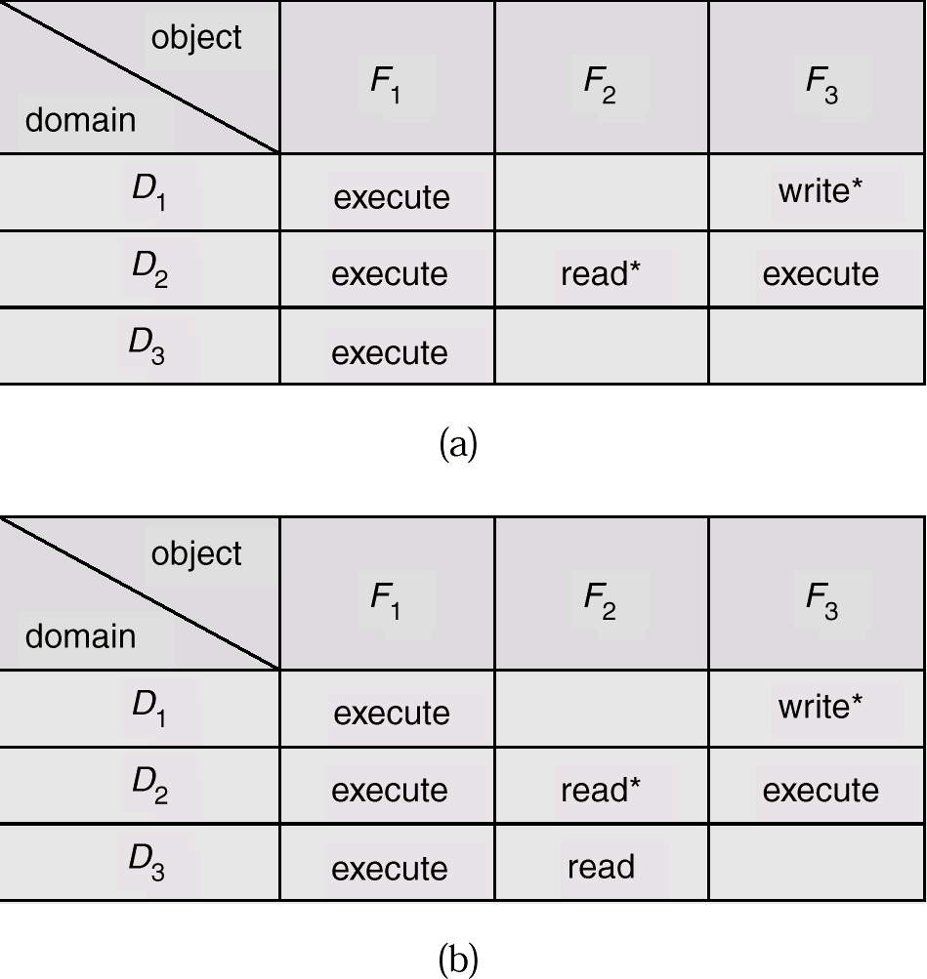
Access Matrix with Copy Rights

Slide 12
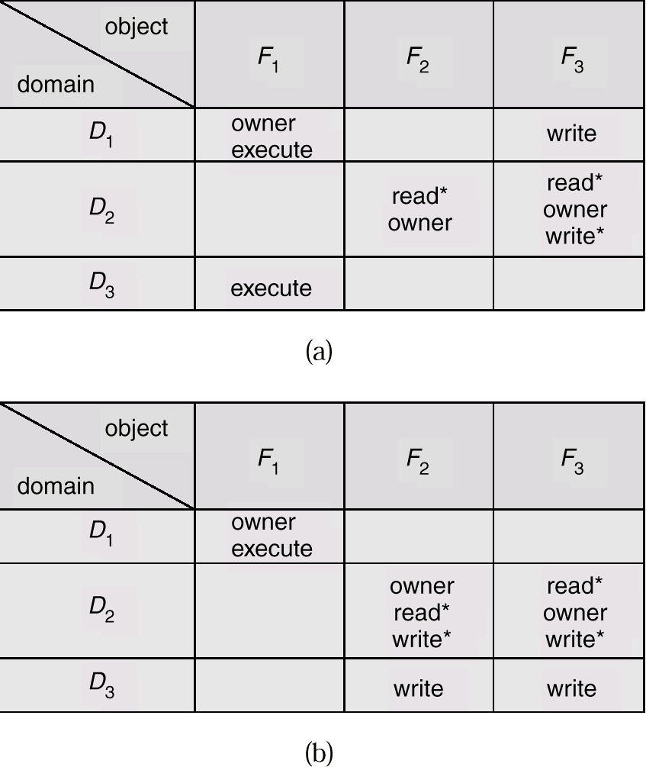
Access Matrix With Owner Rights

Slide 13
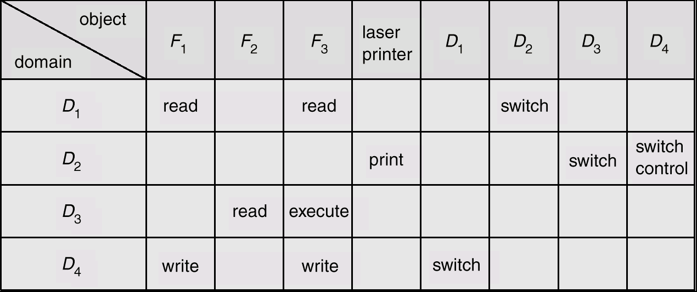
Modified Access Matrix of Figure 2

Slide 14
Revocation of Access Rights
Access List – Delete access rights from access list.
  Simple
  Immediate
Capability List – Scheme required to locate capability in the system before capability can be revoked.
  Reacquisition
  Back-pointers
  Indirection
  Keys

Slide 15
Capability-Based Systems
Hydra
  Fixed set of access rights known to and interpreted by the system.
  Interpretation of user-defined rights performed solely by user's program; system provides access protection for use of these rights.
Cambridge CAP System
  Data capability - provides standard read, write, execute of individual storage segments associated with object.
  Software capability -interpretation left to the subsystem, through its protected procedures.

Slide 16
Language-Based Protection
Specification of protection in a programming language allows the high-level description of policies for the allocation and use of resources.
Language implementation can provide software for protection enforcement when automatic hardware-supported checking is unavailable.
Interpret protection specifications to generate calls on whatever protection system is provided by the hardware and the operating system.

